Slide 1




Slide 2

MAZE SOLVING

Slide 3

TEST TIME ON JOSEPHUS TRAP
URL:https://forms.gle/Dg1PM3HuHVQ7FQbL8
QR CODE:

Slide 4
MAZE SOLVING
Introduction to Backtracking
Backtracking is an algorithmic method to solve a problem in an additional way.
It uses a recursive approach to explain the problems.
We can say that backtracking is needed to find all possible combinations to solve an optimization problem.
Backtracking is a systematic way of trying out different sequences of decisions until we find one that "works."

Slide 5
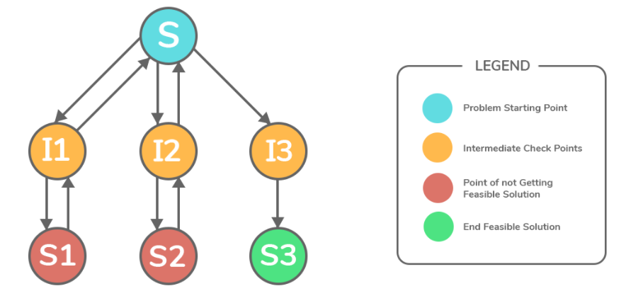
MAZE SOLVING
Introduction to Backtracking
In Backtracking, we "explore" each node, as follows:
Step 1 − if current point is a feasible solution, return success
Step 2 − else if all paths are exhausted (i.e current point is an endpoint), return failure,since we have no feasible solution.
Step 3 − else if current point is not an end point, backtrack and explore other points and repeat above steps.

Slide 6
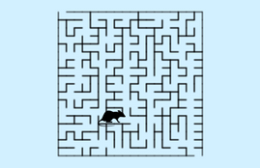
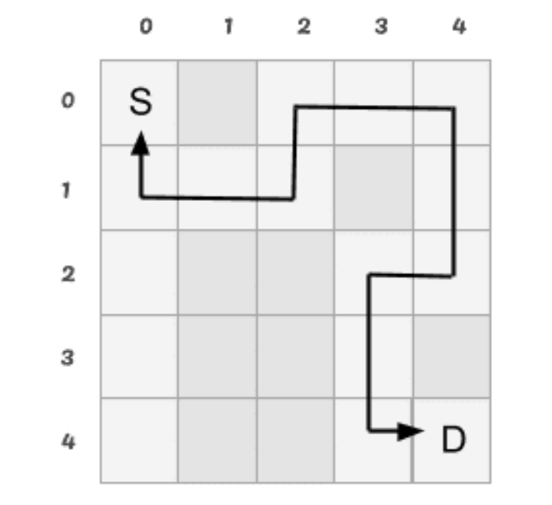
MAZE SOLVING
Introduction to Rat in a Maze
A Maze is given as N*N binary matrix of blocks where source block is the upper left most block maze[0][0] and destination block is lower rightmost block maze[N-1][N-1].
A rat starts from source and has to reach the destination. The rat can move only in two directions: forward and down.

Slide 7
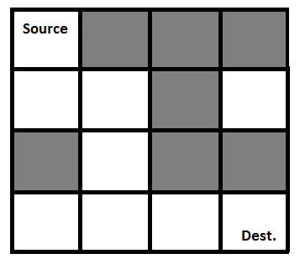
MAZE SOLVING
Introduction to Rat in a Maze
Representing the Maze on the left as the matrix given below
[1, 0, 0, 0
1, 1, 0, 1
0, 1, 0, 0
1, 1, 1, 1]
The Solution Matrix is given below where 1’s represent the path
[1, 0, 0, 0
1, 1, 0, 0
0, 1, 0, 0
0, 1, 1, 1]

Slide 8
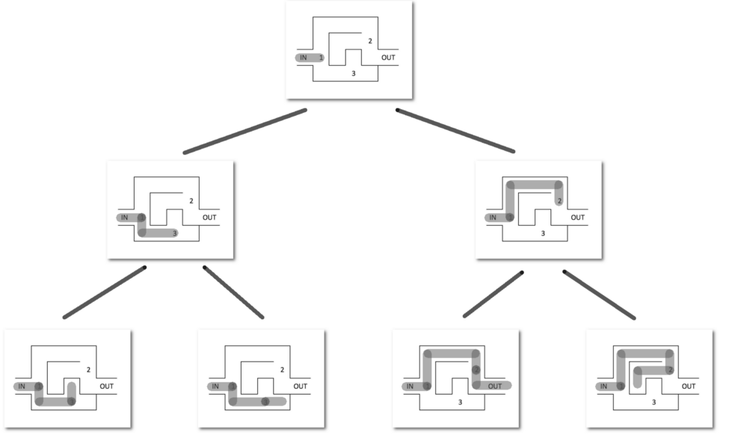
MAZE SOLVING
Approach
Form a recursive function, which will follow a path and check if the path reaches the destination or not.
If the path does not reach the destination then backtrack and try other paths.

Slide 9
MAZE SOLVING
Algorithm
Create a solution matrix, initially filled with 0’s.
Create a recursive function, which takes initial matrix, output matrix and position of rat (i, j).
if the position is out of the matrix or the position is not valid then return.
Mark the position output[i][j] as 1 and check if the current position is destination or not. If destination is reached print the output matrix and return.
Recursively call for position (i+1, j) and (i, j+1).
Unmark position (i, j), i.e output[i][j] = 0.

Slide 10
MAZE SOLVING
Program
Sample IO
Input
int maze[][] = { { 1, 0, 0, 0 },
{ 1, 1, 0, 1 },
{ 0, 1, 0, 0 },
{ 1, 1, 1, 1 } };
Output
1 0 0 0
1 1 0 0
0 1 0 0
0 1 1 1
Time Complexity
O(2^(n*n))
Explanation
The recursion can run upper-bound 2^(n*n) times.
Space Complexity
O(n*n)

Slide 11
MAZE SOLVING
public class RatMaze{ static int N; void printSolution(int sol[][]) { for (int i = 0; i < N; i++) { for (int j = 0; j < N; j++) System.out.print(" " + sol[i][j] + " "); System.out.println(); } } boolean isSafe(int maze[][], int x, int y) { return (x >= 0 && x < N && y >= 0 && y < N && maze[x][y] == 1); } | boolean solveMaze(int maze[][]) { int sol[][] = new int[N][N]; if (solveMazeUtil(maze, 0, 0, sol) == false) { System.out.print("Solution doesn't exist"); return false; } printSolution(sol); return true; } if (solveMazeUtil(maze, x + 1, y, sol)) return true; if (solveMazeUtil(maze, x, y + 1, sol)) return true; if (solveMazeUtil(maze, x - 1, y, sol)) return true;

Slide 12
MAZE SOLVING
if (solveMazeUtil(maze, x, y - 1, sol)) return true; sol[x][y] = 0; return false; } return false; } public static void main(String args[]) { RatMaze m = new RatMaze(); int maze[][] = { { 1, 0, 0, 0 }, { 1, 1, 0, 1 }, { 0, 1, 0, 0 }, { 1, 1, 1, 1 } }; m.solveMaze(maze); } }

Slide 13
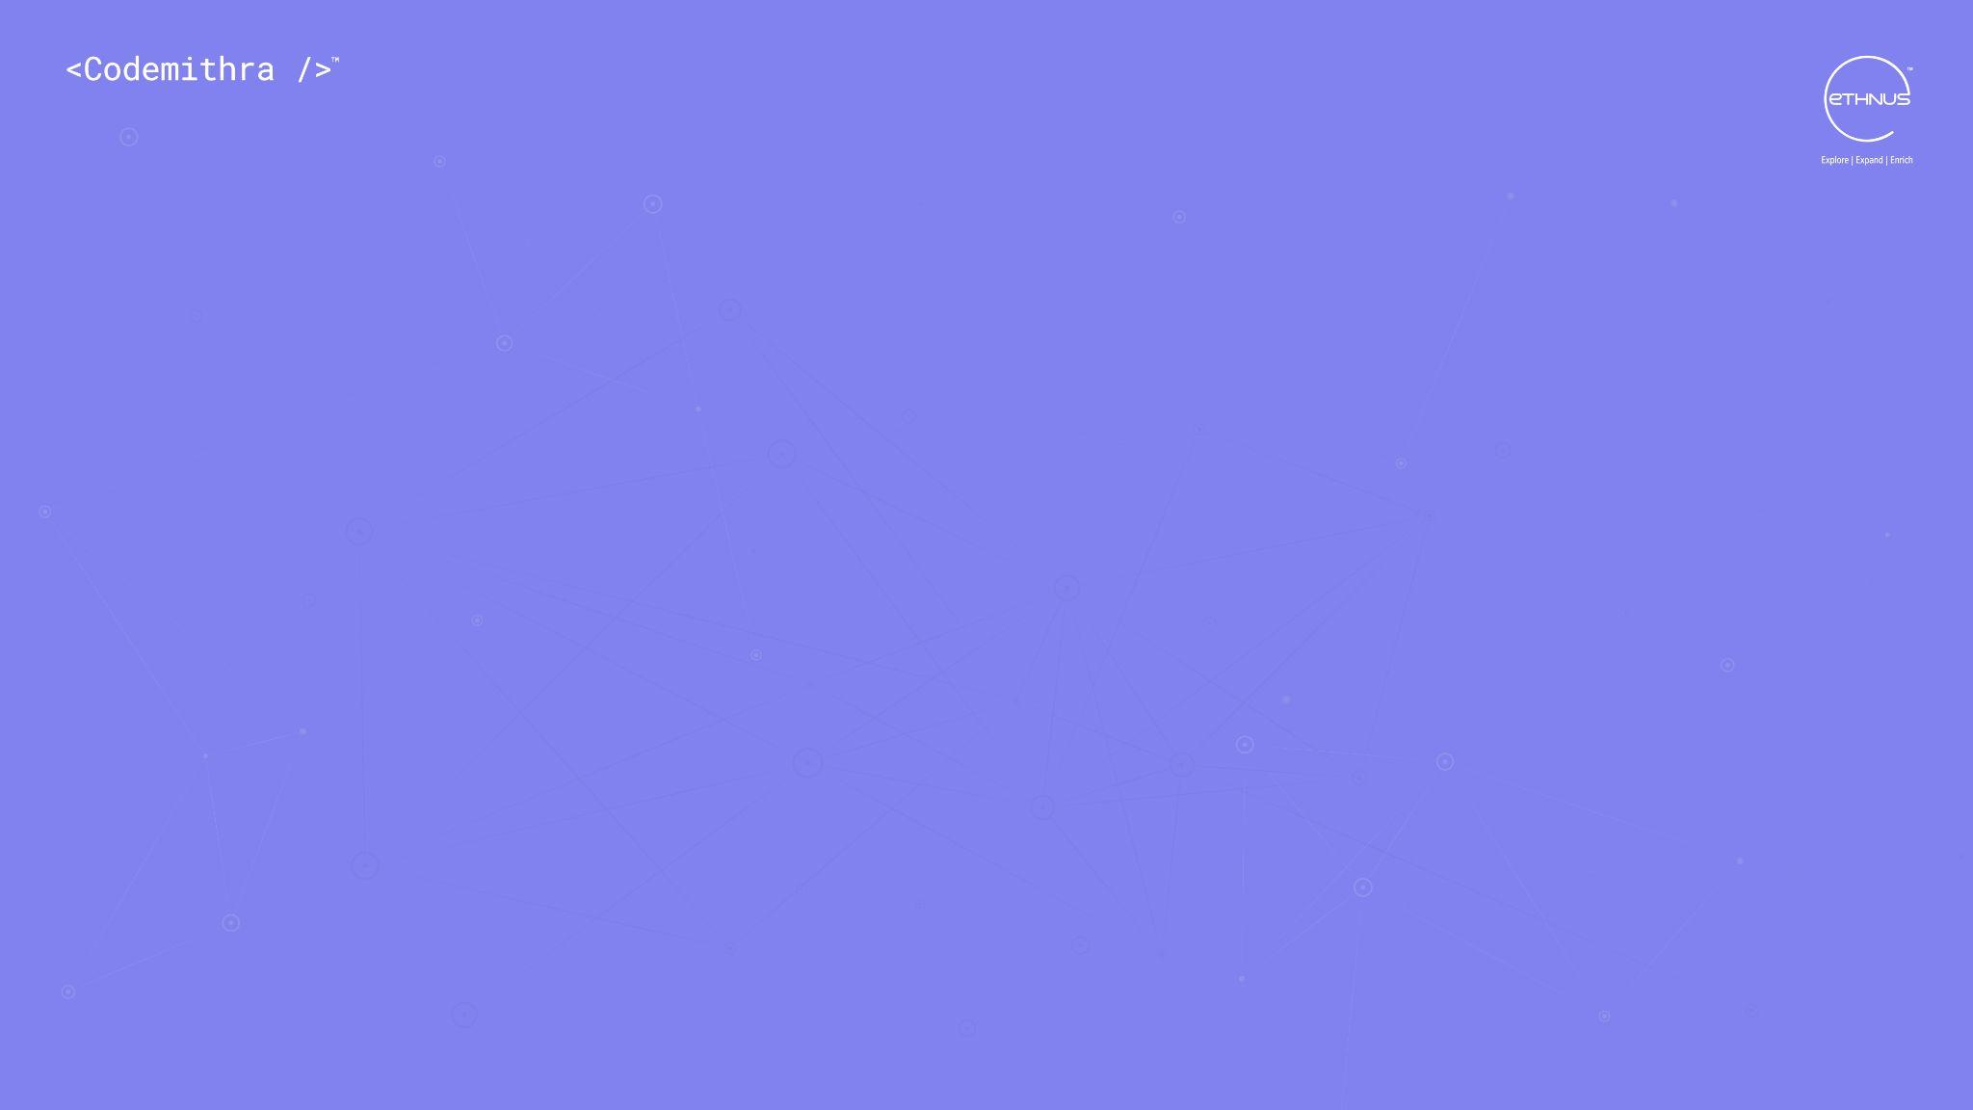



THANK YOU
+91 78150 95095
codemithra@ethnus.com
www.codemithra.com

